Slide 1

Customer Discovery
WEEK NINE
CEO: Rachel Evans
CTO: Sophie Tanker
CFO: Andra Buchan

Slide 2
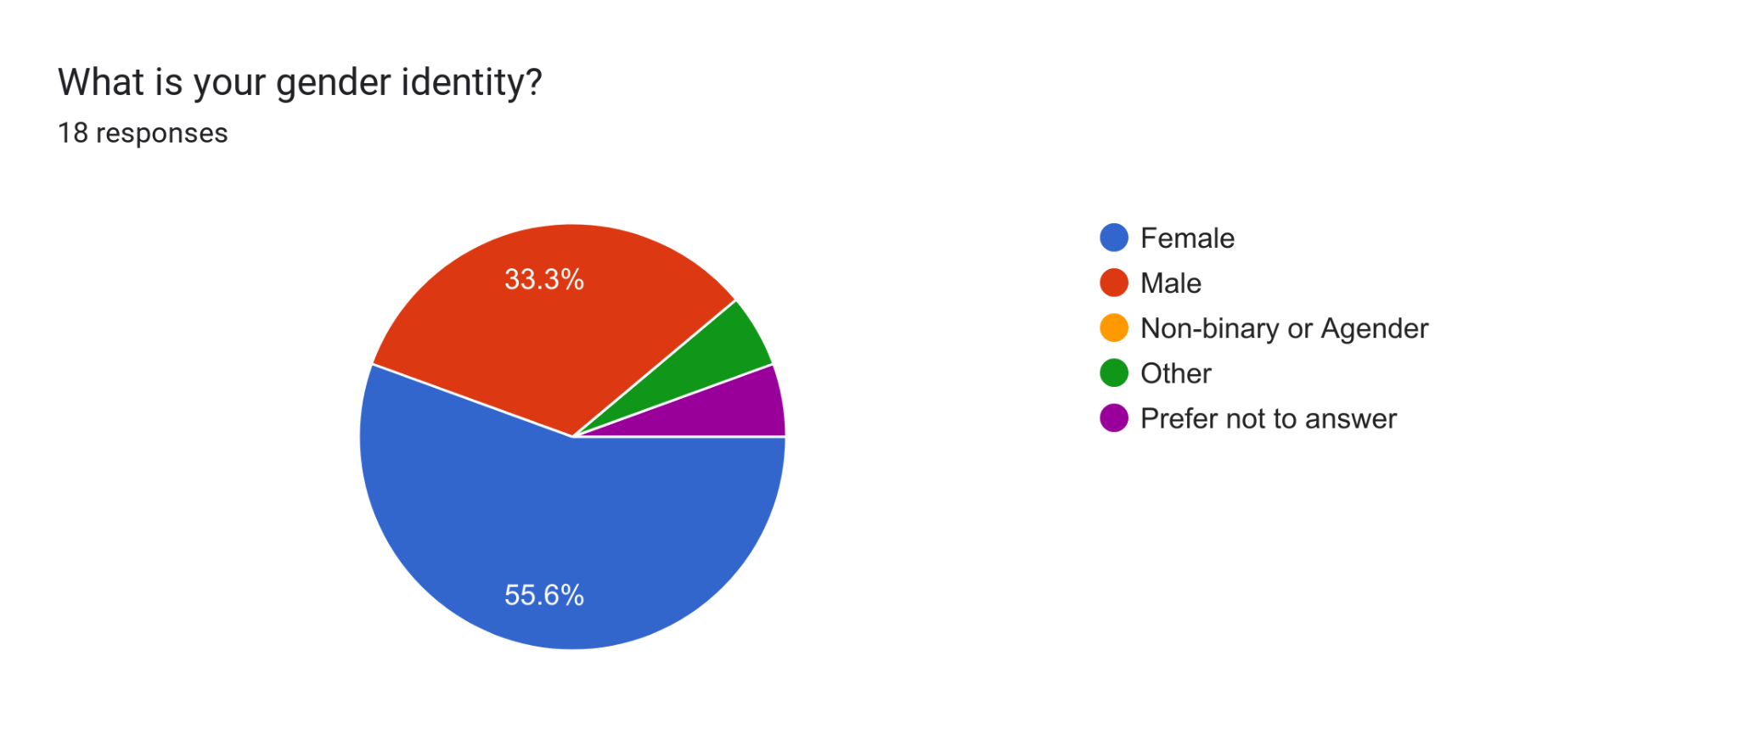
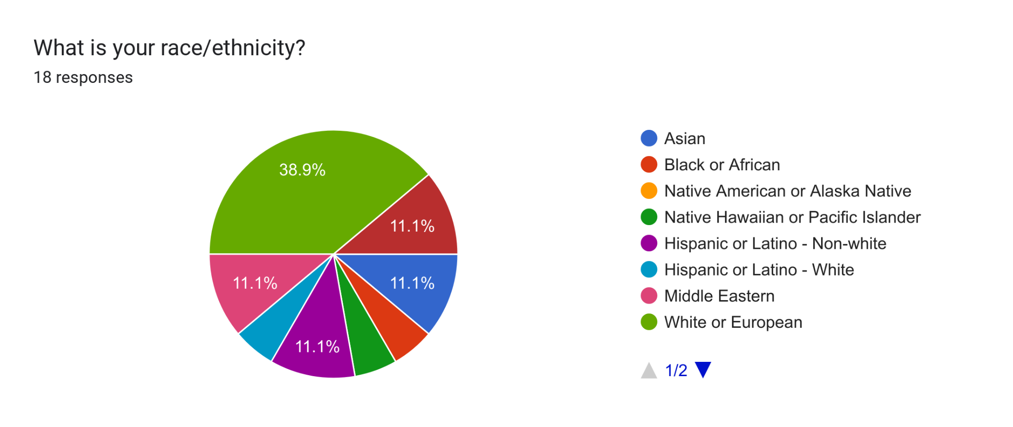
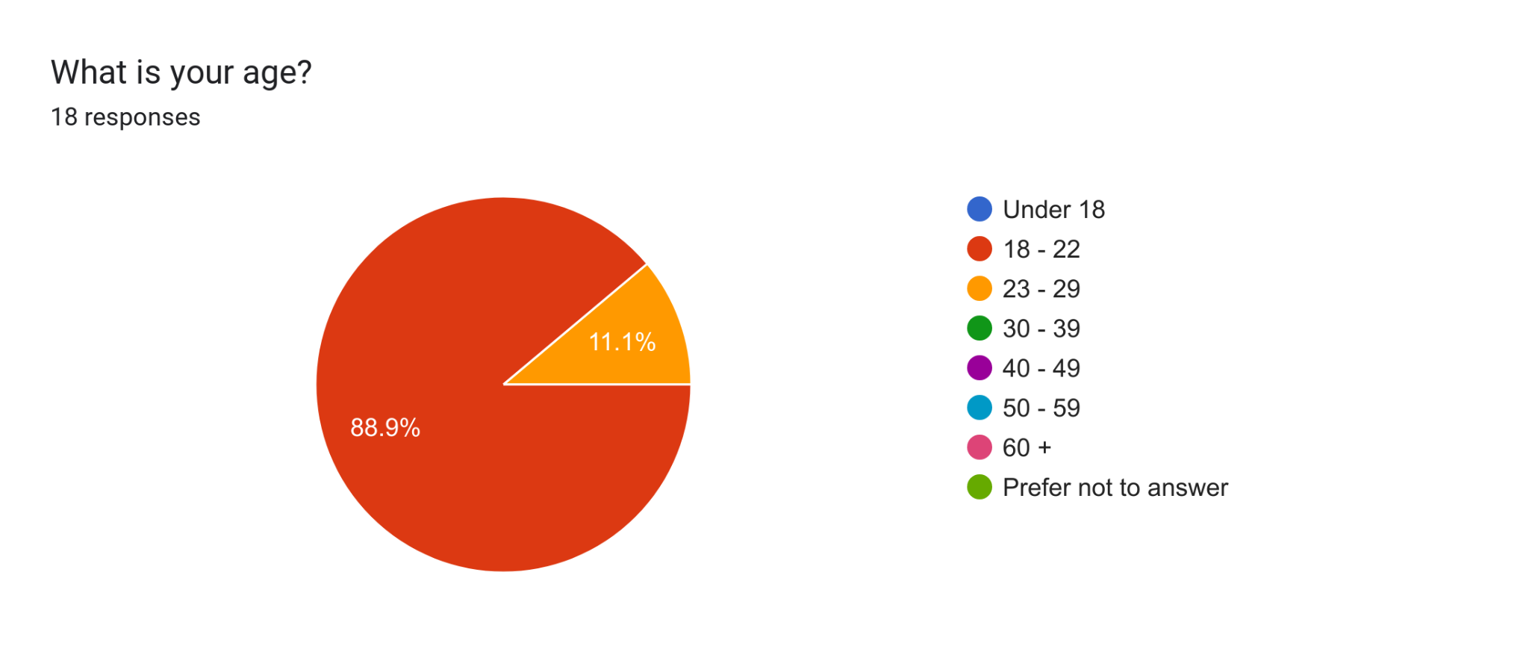
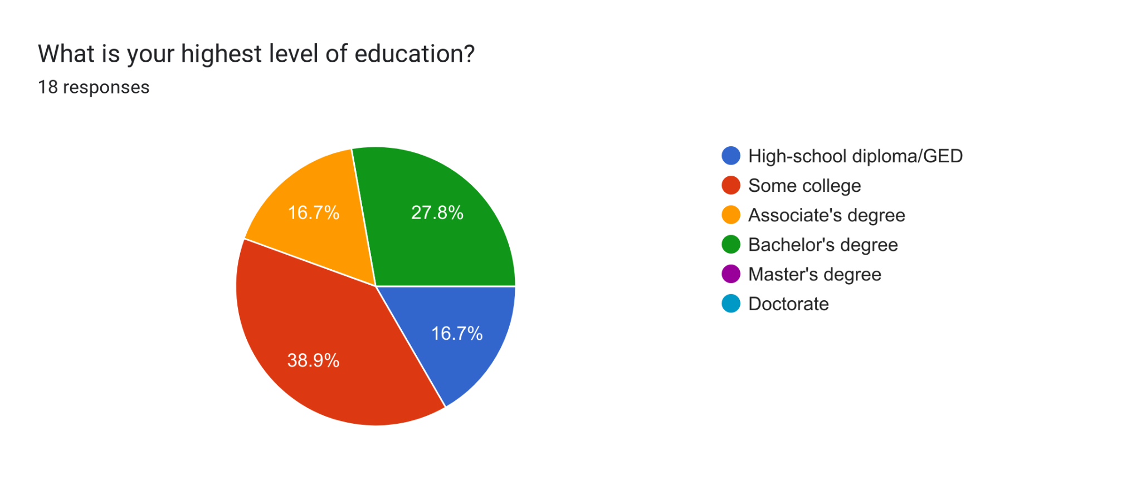
DEMOGRAPHIC INFORMATION

Slide 3
Polling with our Customer Archetypes in mind:
Asked respondents if they identified as an:
Athlete
Individual with a full-time job
Individual with 1+ known vitamin deficiencies
Pregnant/nursing
None of the above

Slide 4
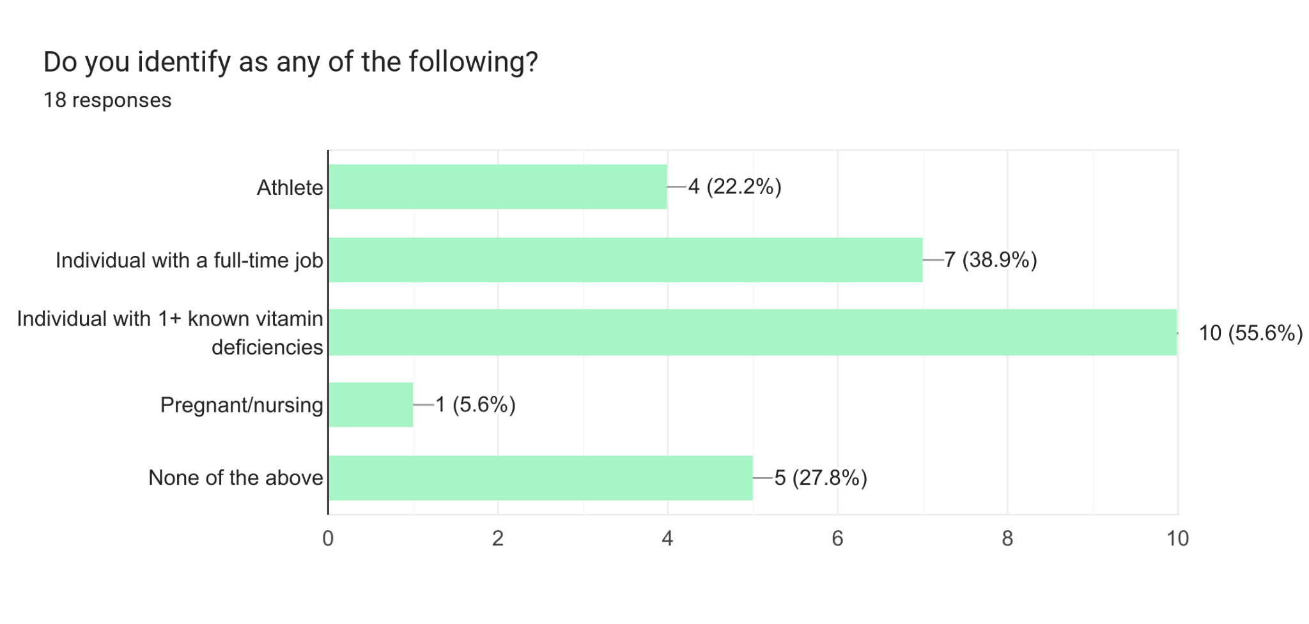
Do you identify as any of the following?

Slide 5
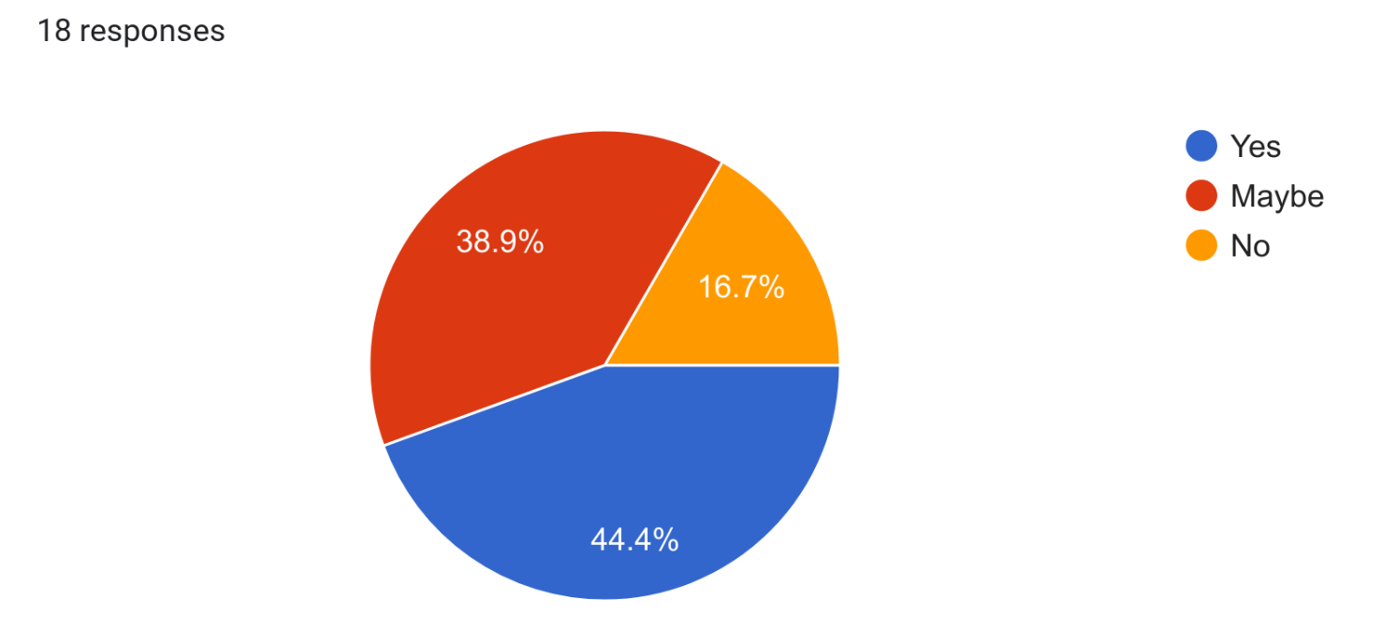
Most people, especially the aforementioned groups, need vitamins to stay healthy and productive. With this in mind, would you consider using a supplement subscription service that delivers supplements straight to your door monthly?

Slide 6

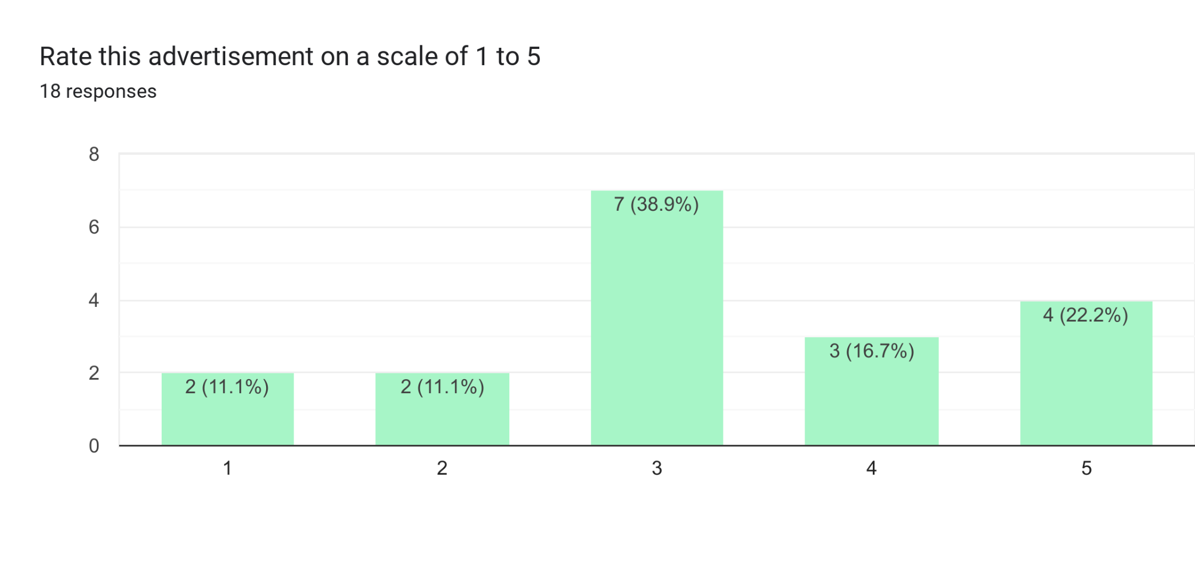

Slide 7

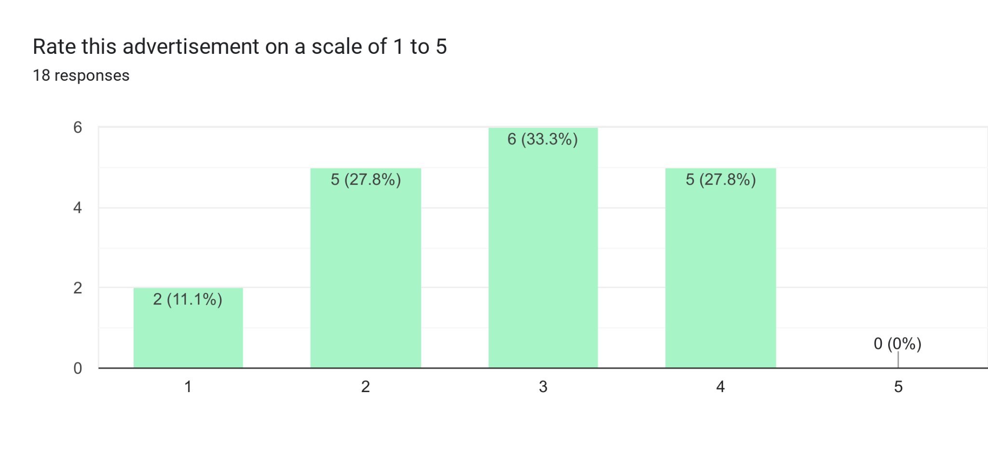

Slide 8
COMMENTS
Advertisement 1: couldnt grasp what you are pitching. A little vague
Advertisement 2: straight to the point and engaging. Makes me curious and want to click the link to learn more.
the colors are great but the single line about the genes immediately raises skepticism
A little more information should be added
The first gives more info but the design could use work. The second just looks suspicious.

Slide 9
TAKEAWAYS
People thought the advertisements were corny, but preferred the one with more information
Adding more information in surveys goes a long way

Slide 10
Thank you!

